Slide 1
FerroElectric Negative Capacitances
by
AKSHAY RANCHOD PATIL

Slide 2
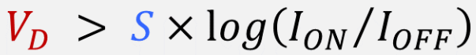
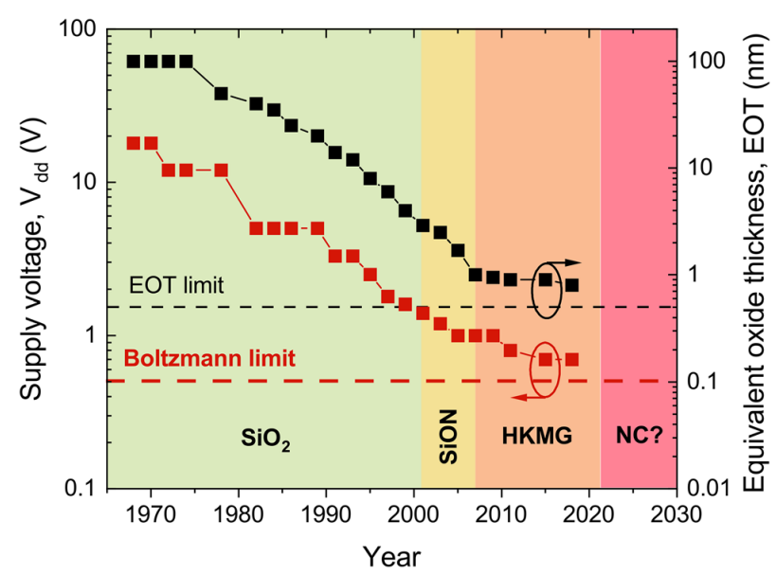
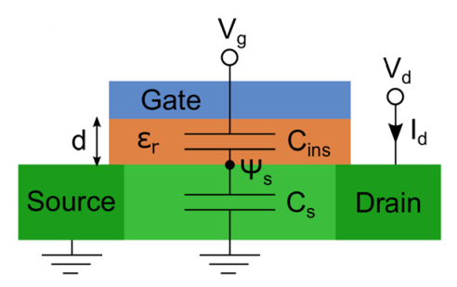
Motivation For the Negative Capacitances
Computational Data grows 50 x every year.
Computing Consumes 2 to 5 percent of the worldwide energy
Need for Power Disscipation at Nano Scale.

Slide 3
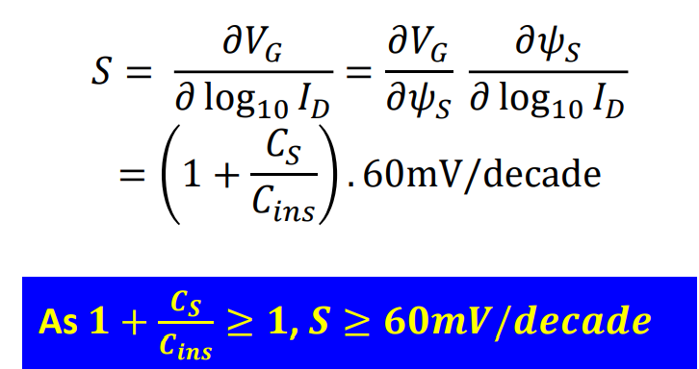
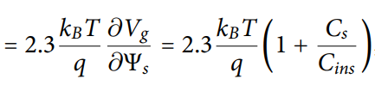
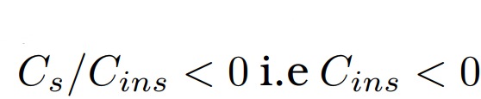
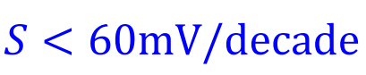
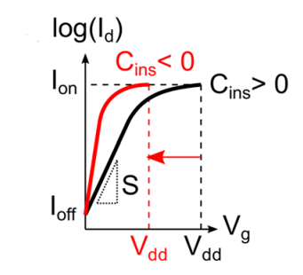
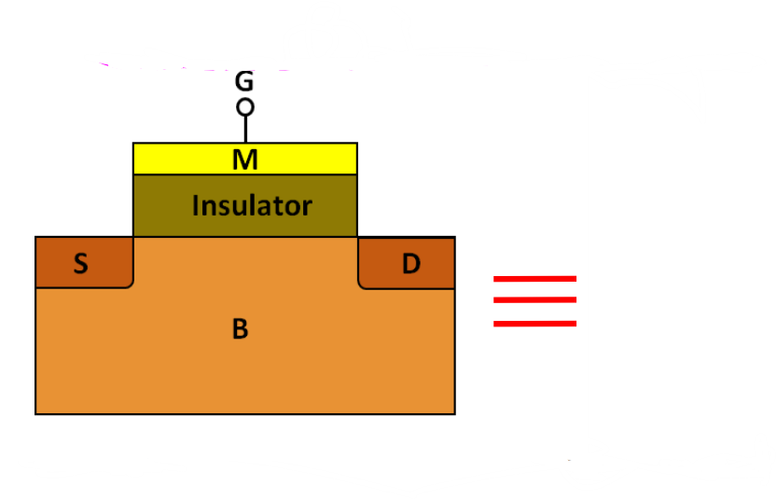
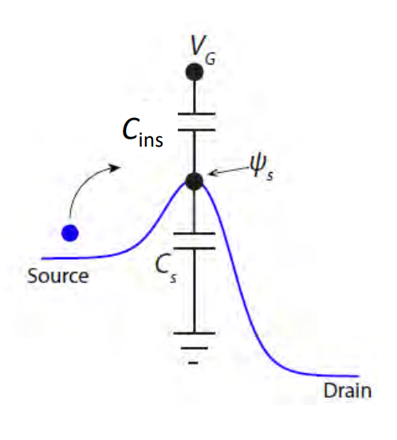
Subthreshold Swing (S)
S is the Amount of gate voltage required to change the current by 1decade.
What if ?

Slide 4
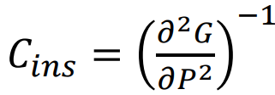
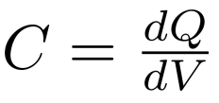
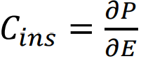
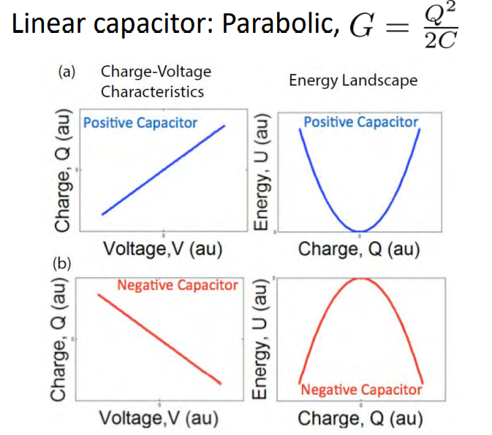
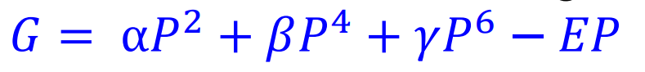
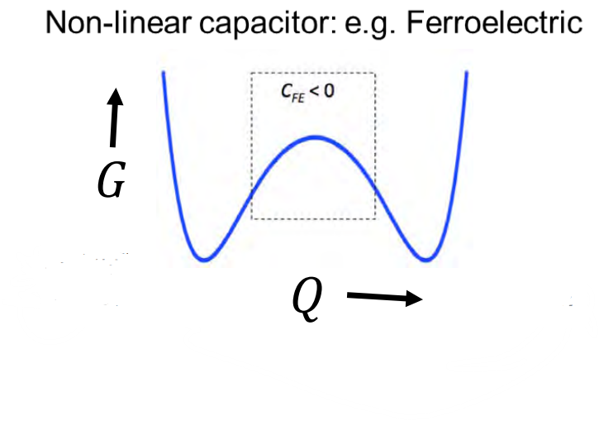
Basics of Capacitance
1.
2.
3.

Slide 5
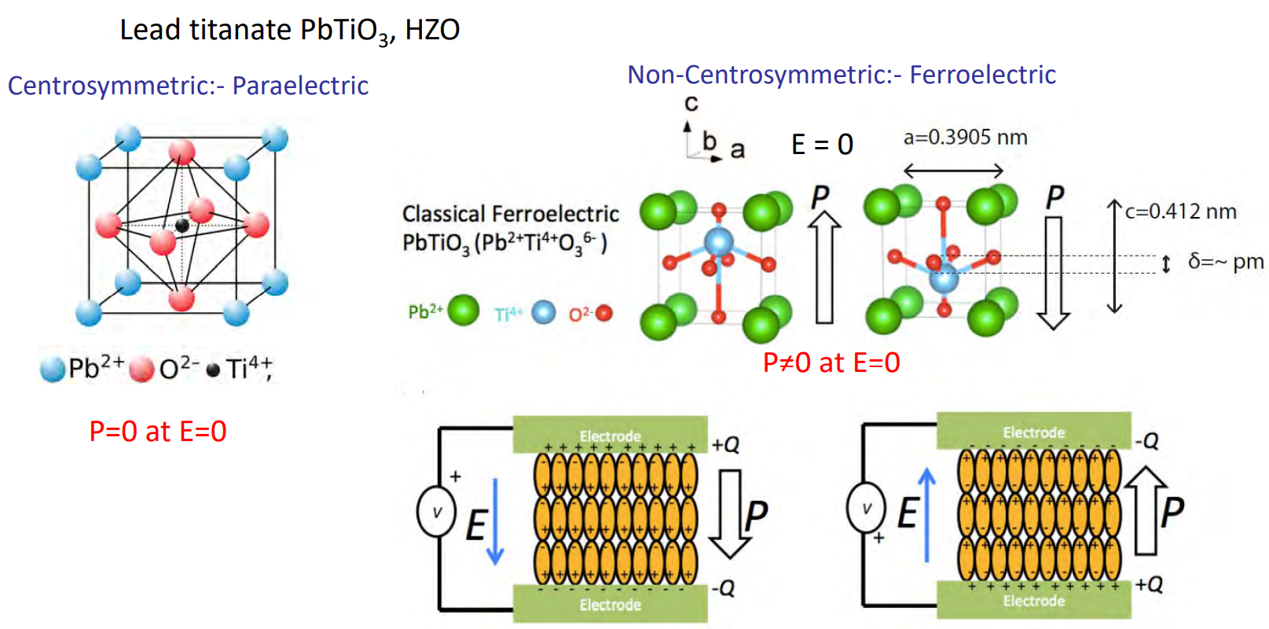
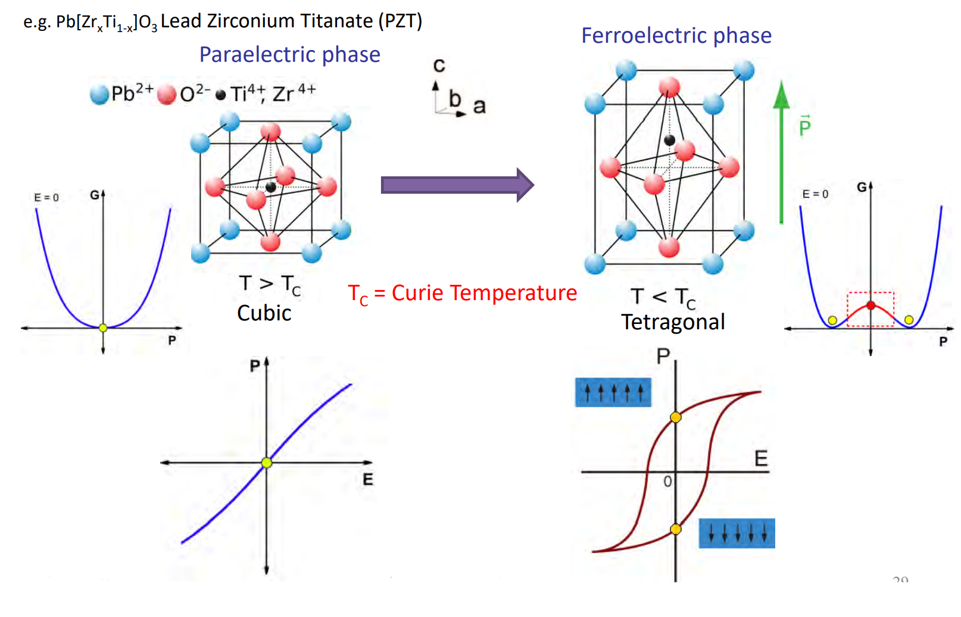
ParaElectric and FerroElectric Materials

Slide 6
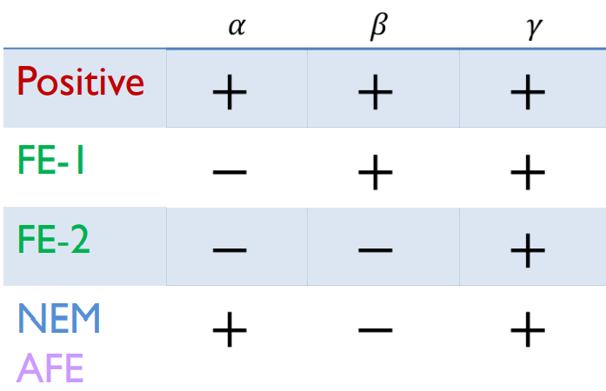
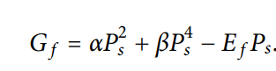
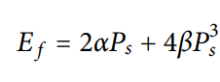
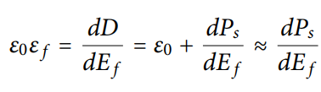
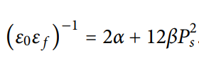
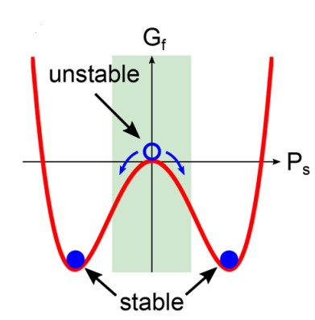
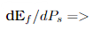
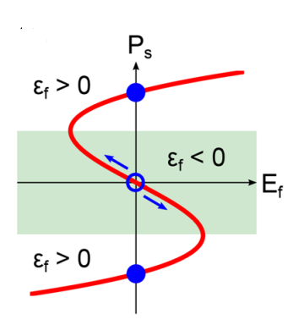
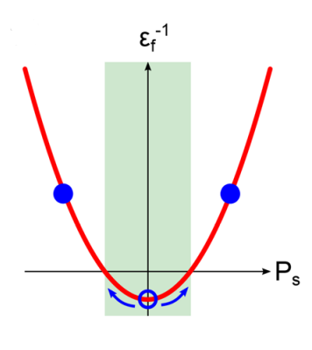
Landau Khalatnikov Theory of Non-Linear dielectrics
Free energy in Non- linear Dielectrics is given by,

Slide 7
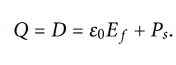
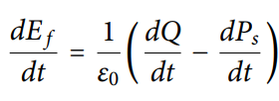
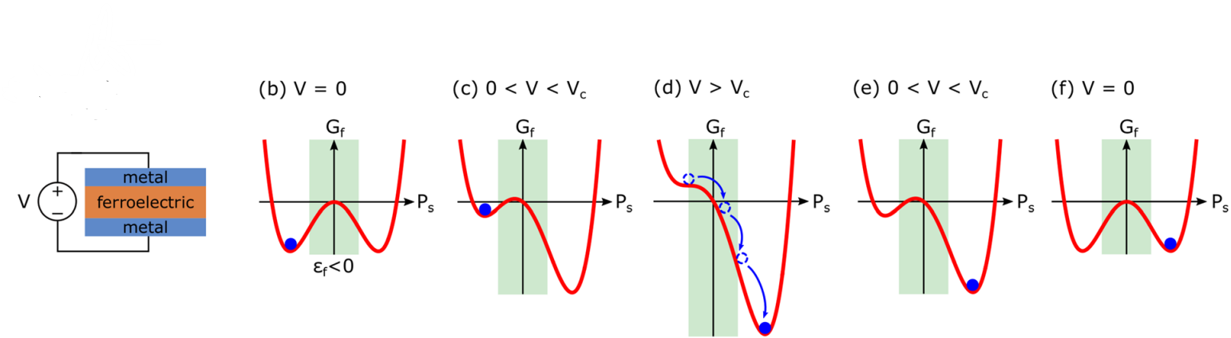
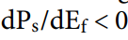
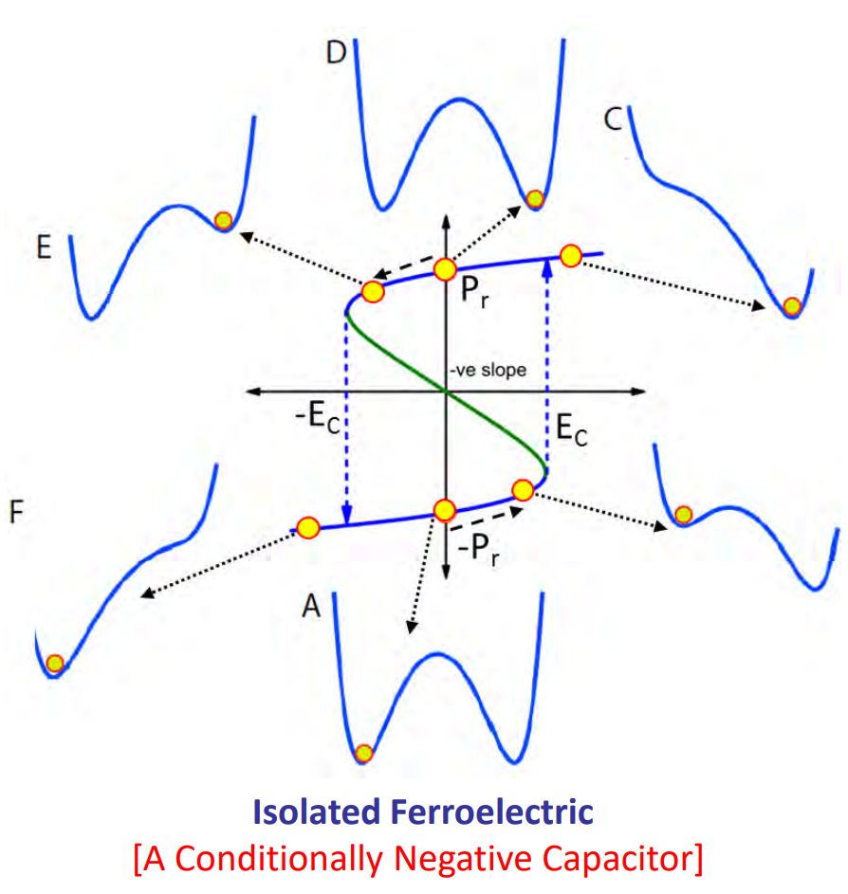
Transient Negative Capacitances
The free charge per unit area on the capacitor electrode is Q
Rearranging,
For Negative Capacitance, and we are switching here from –ve Ps to +ve Ps hence dPs = +ve.
Major Drawbacks In application –
Large Polarization Hysteresis is observed due to irreversible domain nucleation and growth,leads to power discipation and hence increase in supply gate voltage.
Polarization Switching can be fast or slow,but to access the –ve capacitance region it should be slow but then it can’t be used for high speed digital electronics

Slide 8
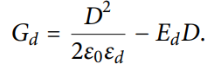
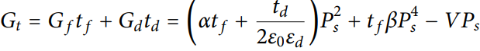
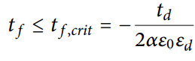
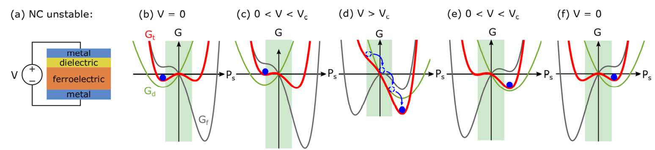
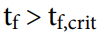
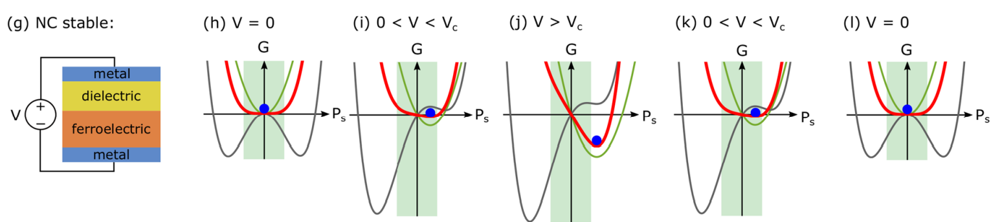
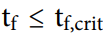
Stabalized Negative Capacitances
1.Add a positive dielectric capacitance layer to MFM to form MDFM layer as shown in the figure.
2.Free Energy of Dielectric with relative permittivity and Electric Field Ed is given as,
3.Total free energy is given by,
4.NC becomes stabalized when i.e the term in the bracket is positive
Because the Gd curvature is always +ve but Gf curvature becomes negative in NC region and hence Gd should balance out this curvature in NC region to give Gt as positive and concave upwards in NC region

Slide 9
Ferroelectrics For NC Devices
For practical realization of NC devices following conditions by Ferroelectrics need to be satisfied –
Robust ferroelectricity at 5 nm thickness and below – 1.Stabilizes NC 2.Scaling Down
Compatibility with CMOS technology – HfO2 based ferroelectrics
Thermal stability on silicon – Should be able to withstand hydrogen Annealing and temperature above 500 C.
Conformal deposition on 3D substrates -
Large electronic bandgap and conduction band offset to Si – To reduce gate leakage current.

Slide 10
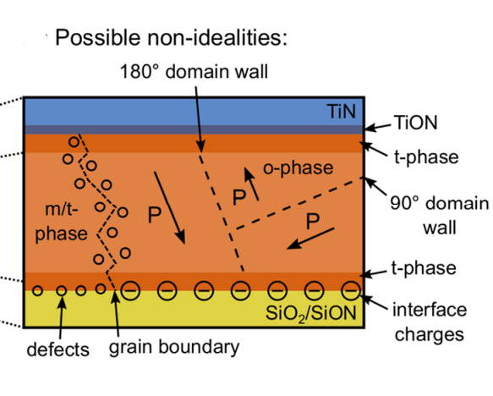
OUTlook
Landau Theory does not take in to account the nucleation and growth and also HfO2 can have non – idealities like Ferroelectric domains,defects etc . Hence detailed study on microstructure should be done as it is the most promising candidate that satifies the previous 5 criterions to realize NC practically.
If no subthreshold swing below the Boltzmann limit is observed, then electrical characteristics have to be compared to an appropriate reference device, which should have as few processing differences as possible, but must have a non-ferroelectric gate oxide.

Slide 11
Potential Applications OF Negative CapaCiTances
Low power Computing Efficiently
Neuromorphic and Intelligent Computing
Performance booster for Complementary MOS transistors.
Building SRAM of the computers
Reduce topological transistor Switching Energy
Inverters, etc

Slide 12
References
Michael Hoffmann, Stefan Slesazeck, and Thomas Mikolajick ,"Progress and future prospects of negative capacitance electronics: A materials perspective", APL Materials 9, 020902 (2021)
Modeling and Simulation of Negative Capacitance Transistors by Yogesh S Chauhan.
A Tutorial Introduction to Negative Capacitor Field Effect Transistors: Perspective on The Road Ahead by Muhammad A. Alam

Slide 13
Thank you!

